Slide 1
File and Input/output Streams

Slide 2
The File Class
Data stored in variables, arrays, and objects are temporary; they are lost when the program terminates.
To permanently store the data created in a program, you need to save them in a file on a disk or a CD.
File class is present in java.io package and It deals directly with files and the file system.
Every file is placed in a directory in the file system.
An absolute file name contains a file name with its complete path and drive letter.
For example, c:\book\Welcome.java is the absolute file name for the file Welcome.java on the Windows operating system. Here c:\book is referred to as the directory path for the file.
Absolute file names are machine dependent

Slide 3
Do not use absolute file names in your program. Why?
You should use a file name relative to the current directory. Known as relative path For example,
you may create a File object using new File("Welcome.java") for the file Welcome.java in the current directory.
You may create a File object using new File(“abc/Welcome .java").
The forward slash(/) is the Java directory separator, which will work same as in other platform.
The File class does not specify how information is retrieved from or stored in files.
File class can be used to obtain used to obtain or manipulate the information associated with a disk file, such as file permissions, renaming or delete a file.

Slide 4
A directory is a File that contains a list of other files and directories.
The following constructors can be used to create File objects:
File(String directoryPath)
File(String directoryPath, String filename)
File(File dirObj, String filename)
Here , directoryPath is the path name of the file, filename is the name of the file or subdirectory, and dirObj is a Fileo bject that specifies a directory that describes a file.

Slide 5
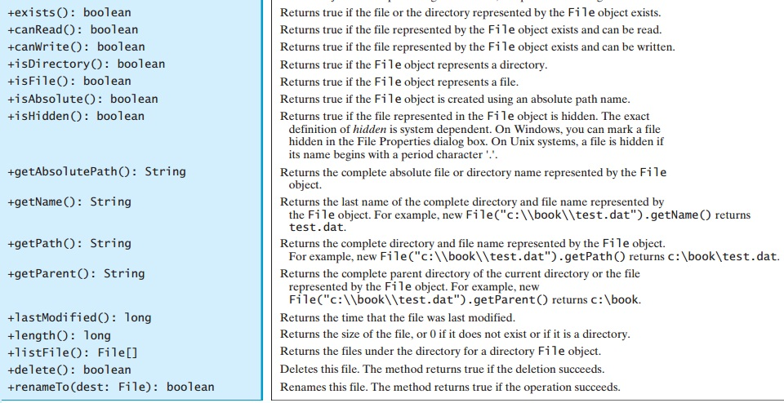

Slide 6
public boolean createNewFile() throws IOException: Atomically creates a new, empty file named if and only if a file with this name does not yet exist.
A File object encapsulates the properties of a file or a path, but does not contain the methods for reading/writing data from/to a file.
In order to perform I/O, you need to create objects using appropriate Java I/O classes.

Slide 7
import java.io.File;
class FileDemo {
public static void main(String args[])
{
File f1 = new File("/java/COPYRIGHT");
System.out.println("File Name: " + f1.getName());
System.out.println("Path: " + f1.getPath());
System.out.println("Abs Path: " + f1.getAbsolutePath());
System.out.println("Parent: " + f1.getParent());
System.out.println(f1.exists() ? "exists" : "does not exist");
System.out.println(f1.canWrite() ? "is writeable" : "is not writeable");
System.out.println(f1.canRead() ? "is readable" : "is not readable");
System.out.println("is " + (f1.isDirectory() ? "" : "not" + " a directory"));
System.out.println(f1.isFile() ? "is normal file" : "might be a named pipe");
System.out.println(f1.isAbsolute() ? "is absolute" : "is not absolute");
System.out.println("File last modified: " + f1.lastModified());
System.out.println("File size: " + f1.length() + " Bytes");
}
}

Slide 8
Text I/O vs Binary I/O
Data stored in a binary file are represented in binary form. You cannot read binary files. They are designed to be read by programs.
Computers do not differentiate binary files and text files. All files are stored in binary format, and thus all files are essentially binary files.
Text I/O is built upon binary I/O to provide a level of abstraction for character encoding and decoding.
Encoding and decoding are automatically performed by the for text I/O.

Slide 9
Streams
Java programs perform I/O through streams. A stream is an abstraction that either produces or consumes information.
A stream is linked to a physical device by the Java I/O system.
All streams behave in the same manner, even if the actual physical devices to which they are linked differ. Thus, the same I/O classes and methods can be applied to any type of device.
All these streams represent an input source and an output destination

Slide 10
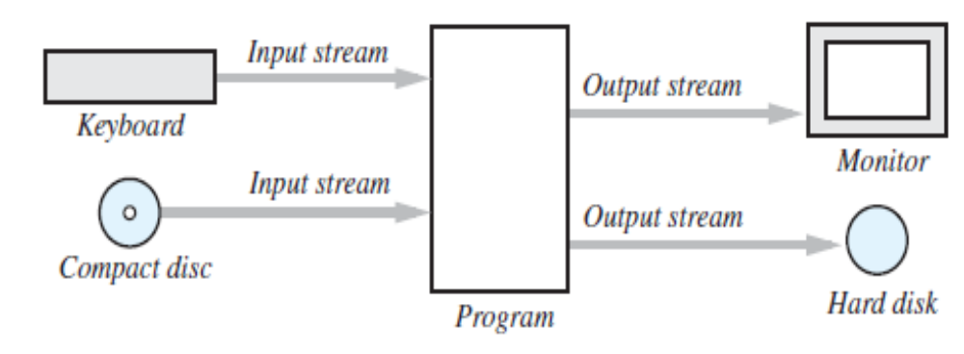
The Concept of a Stream
A stream is a flow of data. The data might be characters, numbers, or bytes consisting of binary digits.
If the data flows into your program, the stream is called an input stream.
If the data flows out of your program, the stream is called an output stream.
For example, if an input stream is connected to the keyboard, the data flows from the keyboard into your program. If an input stream is connected to a file, the data flows from the file into your program. Figure below illustrates some of these streams.

Slide 11
Byte Streams and Character Streams
Java defines two types of streams: byte and character.
Byte streams provide a convenient means for handling input and output of bytes. Byte streams are used, for example, when reading or writing binary data.
Programs use byte streams to perform input and output of 8-bit bytes. All byte stream classes are descended from InputStream and OutputStream.
Character streams provide a convenient means for handling input and output of characters.
The Java platform stores character values using Unicode conventions. Character stream I/O automatically translates this internal format to and from the local character set.
At the lowest level, all I/O is byte-oriented. The character-based streams simply provide a convenient and efficient means for handling characters.
ll character stream classes are descended from Reader and Writer.

Slide 12
Question?
Why Use Files for I/O?
Text Files and Binary Files
Should I use a text file or a binary file?
Byte stream and character stream

Slide 13
The Byte Stream Classes
Byte streams are defined by using two class hierarchies. At the top are two abstract classes: InputStream and OutputStream.
Each of these abstract classes has several concrete subclasses that handle the differences between various devices, such as disk files, network connections, and even memory buffers.
The abstract classes InputStream and OutputStream define several key methods that the other stream classes implement. Two of the most important are read( ) and write( ), which, respectively, read and write bytes of data.
Both methods are declared as abstract inside InputStream and OutputStream. They are overridden by derived stream classes.

Slide 14
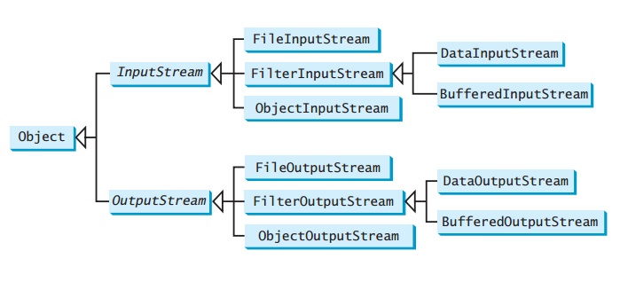
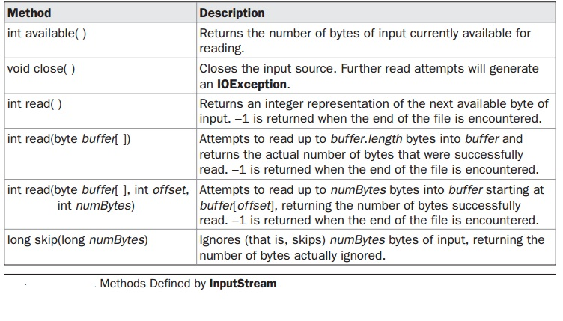

Slide 15
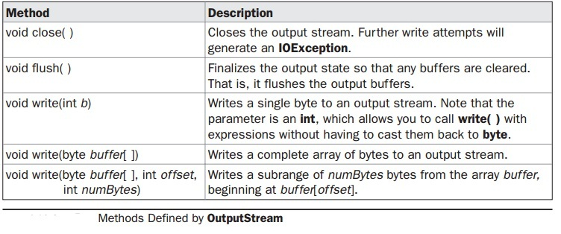

Slide 16
The Character Stream Classes
Character streams are defined by using two class hierarchies. At the top are two abstract classes, Reader and Writer.
These abstract classes handle Unicode character streams. Java has several concrete subclasses of each of these.
The abstract classes Reader and Writer define several key methods that the other stream classes implement. Two of the most important methods are read( ) and write( ).

Slide 17
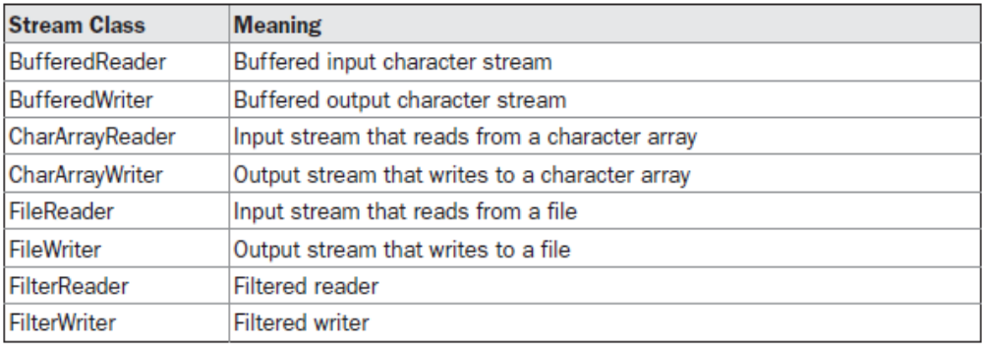
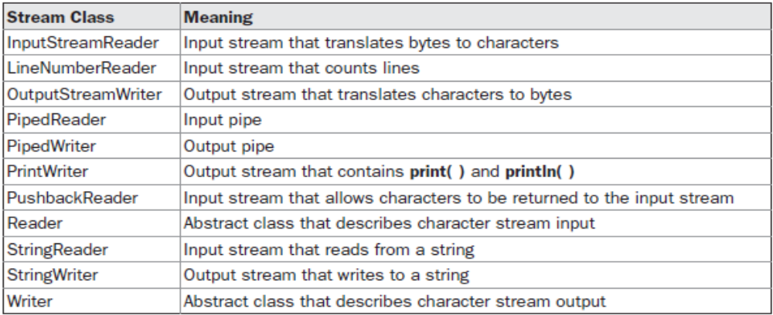
The Character Stream Classes

Slide 18
The Predefined Streams
As all Java programs automatically import the java.lang package. This package defines a class called System, which encapsulates several aspects of the run-time environment.
For example, using some of its methods, we can obtain the current time and the settings of various properties associated with the system.
System also contains three predefined stream variables: in, out, and err.
These fields are declared as public, static, and final within System.
System.out refers to the standard output stream. By default, this is the console. System.in refers to standard input, which is the keyboard by default. System.err refers to the standard error stream, which also is the console by default.
System.in is an object of type InputStream; System.out and System.err are objects of type PrintStream. These are byte streams, even though they typically are used to read and write characters from and to the console. As we can wrap these within character based streams, if desired.

Slide 19
FileInputStream
The FileInputStream class creates an InputStream that you can use to read bytes from a file. Its two most common constructors are shown here:
FileInputStream(String filepath)
FileInputStream(Filefile Obj)
Either can throw a FileNotFoundException. Here,filepathis the full path name of a file, and fileObj is a File object that describes the file.

Slide 20
import java.io.*;
public class InputStreamDemo
{ public static void main(String[] args) throws IOException
{ FileInputStream fis = null;
int i = 0;
char c;
try
{ fis = new FileInputStream("test.txt");
while((i=fis.read())!=-1)
{
c=(char)i;
System.out.print(c);
}
}
catch(FileNotFoundException ex){ }
finally{ if(fis!=null)
fis.close();
}
}
}

Slide 21
FileOutputStream
FileOutputStream creates an OutputStream that you can use to write bytes to a file. Its most commonly used constructors are shown here:
FileOutputStream(String filePath)
FileOutputStream(File fileObj)
FileOutputStream(String filePath, boolean append)
FileOutputStream(File fileObj, boolean append)
They can throw a FileNotFoundException. Here, filePathis the full path name of a file, and fileObjis aFileobject that describes the file. Ifappend is true, the file is opened in append mode.
Creation of a FileOutputStream is not dependent on the file already existing. FileOutputStream will create the file before opening it for output when you create the object. In the case where you attempt to open a read-only file, anIOExceptionwill be thrown.

Slide 22
Closing a stream when it's no longer needed is very important — A finally block to guarantee that streams will be closed even if an error occurs. This practice helps avoid serious resource leaks.
Since test.txt contains character data, the good approach is to use character streams. There are also streams for more complicated data types. Byte streams should only be used for the most primitive I/O.

Slide 23
import java.io.*;
public class OutputStreamDemo
{
public static void main(String[] args) throws IOException
{
FileOutputStream fos = null;
String s = "This text will be written in the file";
byte buf[] = s.getBytes();
try
{
fos = new FileOutputStream("test1.txt");
for (int i=0; i < buf.length; i++)
{
fos.write(buf[i]);
}
}catch(FileNotFoundException e){}
finally
{
fos.close();
}
}
}

Slide 24
Character Streams
The Java platform stores character values using Unicode conventions. Character stream I/O automatically translates this internal format to and from the local character set.
For most applications, I/O with character streams is no more complicated than I/O with byte streams. Input and output done with stream classes automatically translates to and from the local character set.
Character streams are defined by using two class hierarchies.
At the top are two abstract classes, Reader and Writer.
These abstract classes handle Unicode character streams.
Similar to Byte Streams, read() and write() methods are defined in Reader and Writer class.

Slide 25
The Character Stream Classes

Slide 26
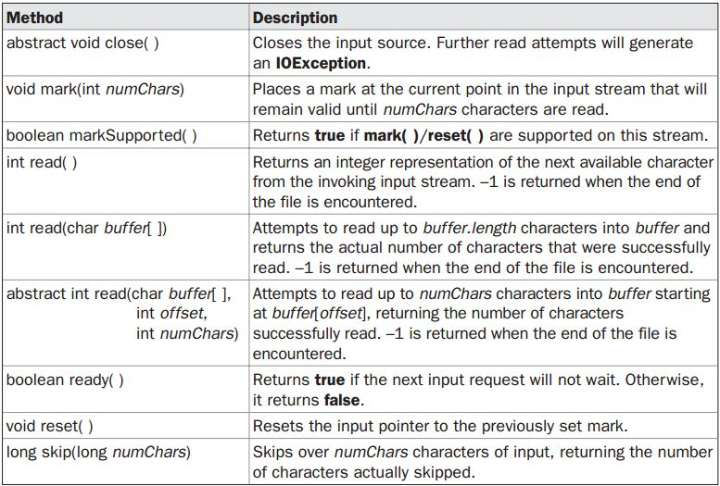
Methods defined by ‘Reader’
Ravi Kant Sahu, Asst. Professor @ Lovely Professional University, Punjab (India)

Slide 27
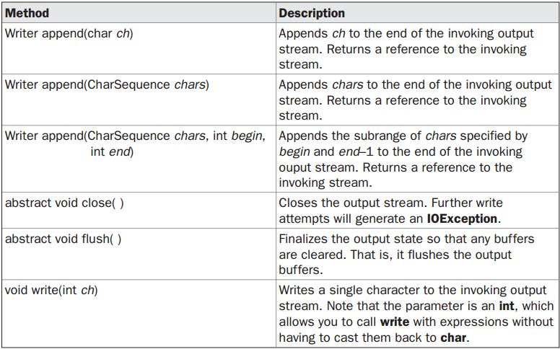
Methods defined by ‘Writer’

Slide 28
The Character Streams
FileReader/FileWriter class
The FileReader class creates a Reader that you can use to read the contents of a file. Its two most commonly used constructors are shown here:
FileReader(String filePath)
FileReader(File fileObj)
Either can throw a FileNotFoundException. Here,filePath is the full path name of a file, and fileObj is a Fileobject that describes the file.
FileWriter creates a Writer that you can use to write to a file. Its most commonly used constructors are shown here:
FileWriter(String filePath)
FileWriter(String filePath, boolean append)
FileWriter(File fileObj)
FileWriter(File fileObj, boolean append)
They can throw an IOException.
Creation of a FileWriter is not dependent on the file already existing. FileWriter will create the file before opening it for output when you create the object.

Slide 29
import java.io.*;
class FileReaderDemo
{
public static void main(String args[]) throws IOException
{FileReader fr = null;
int i;
try
{
fr = new FileReader("test.txt");
while((i = fr.read()) != -1)
{
System.out.print((char)i);
}
}catch(FileNotFoundException e){}
finally{
fr.close();
}
}
}

Slide 30
import java.io.*;
class FileWriterDemo
{
public static void main(String args[]) throws IOException
{
String s = "Testing of File Writer";
char buf[] = new char[s.length()];
buf = s.toCharArray();
FileWriter fw = new FileWriter("file1.txt");
for (int i=0; i < buf.length; i++) {
fw.write(buf[i]);
}
fw.close();
}
}

Slide 31
Two Ways to Close a Stream
Beginning with JDK 7, there are two basic ways in which you can close a stream. The first is to explicitly call close( ) on the stream.
This is the traditional approach that has been used since the original release of Java. With this approach, close( ) is typically called within a finally block.
Thus, a simplified skeleton for the traditional approach is shown here:
try {
// open and access file
} catch( I/O-exception) {
// ...
} finally {
// close the file
}
The second approach to closing a stream is to automate the process by using the try-with-resources statement that was added by JDK 7

Slide 32
The try-with-resources Statement
The try-with-resources statement is a try statement that declares one or more resources. A resource is an object that must be closed after the program is finished with it
The try-with-resources statement is an enhanced form of try that has the following form:
try (resource-specification)
{
// use the resource
}
Here, resource-specification is a statement or statements that declares and initializes a resource, such as a file or other stream-related resource.
It consists of a variable declaration in which the variable is initialized with a reference to the object being managed. When the try block ends, the resource is automatically released. In the case of a file, this means that the file is automatically closed. Thus, there is no need to call close( ) explicitly.

Slide 33
Here are three key points about the try-with-resources statement:
• Resources managed by try-with-resources must be objects of classes that implement java.lang.AutoCloseable
• The resource declared in the try is implicitly final.
• You can manage more than one resource by separating each declaration by a semicolon.

Slide 34
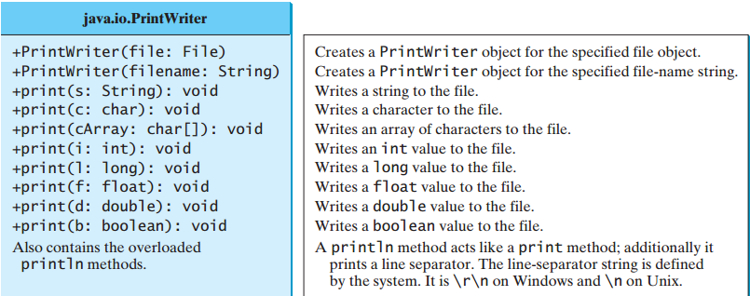
Writing Data into file using PrintWriter
Thejava.io.PrintWriter class can be used to create a file and write data to a text file.
PrintWriter output = newPrintWriter(filename);
Then, you can invoke the print,println methods on PrintWriter object

Slide 35
public class PrintWriterDemo
{
public static void main(String[] args) throws Exception {
java.io.File f = new java.io.File("b.txt");
java.io.PrintWriter output = new java.io.PrintWriter(f);
output.print("Java class ");
output.println(40);
output.print("LPU ");
output.println(85.5);
output.print('a');
output.close();
}
}

Slide 36
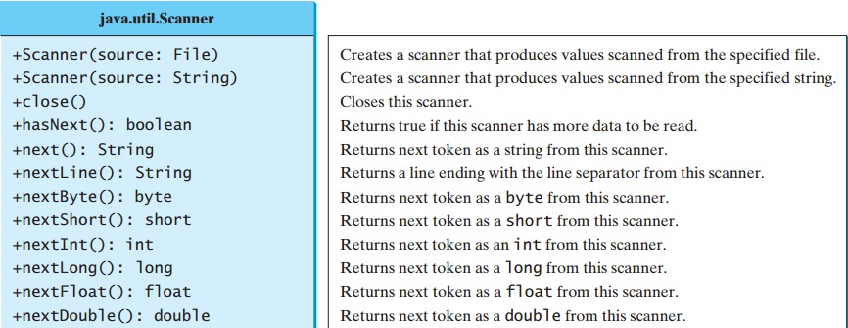
Reading file Using Scanner
The java.util.Scanner class was used to read strings and primitive values from the console
Scanner input = new Scanner(System.in);
To read from a file, create a Scanner for a file, as follows:
Scanner input = new Scanner(new File(filename));

Slide 37
import java.util.Scanner;
public class ReadFile {
public static void main(String[] args) throws Exception
{
java.io.File file = new java.io.File("b.txt");
Scanner input = new Scanner(file);
while(input.hasNext())
{
String s = input.nextLine();
System.out.println(s);
}
input.close();
}
}

Slide 38
Serialization
Serialization is the process of writing the state of an object to a byte stream.
This is useful when we want to save the state of our program to a persistent storage area, such as a file.
At a later time, we may restore these objects by using the process of de-serialization.
Serialization is also needed to implement Remote Method Invocation (RMI).

Slide 39
Serialization: Interfaces and Classes
An overview of the interfaces and classes that support serialization follows:
Serializable
  Only an object that implements the Serializable interface can be saved and restored by the serialization facilities.
  The Serializable interface defines no members.
  It is simply used to indicate that a class may be serialized.
  If a class is serializable, all of its subclasses are also serializable.

Slide 40
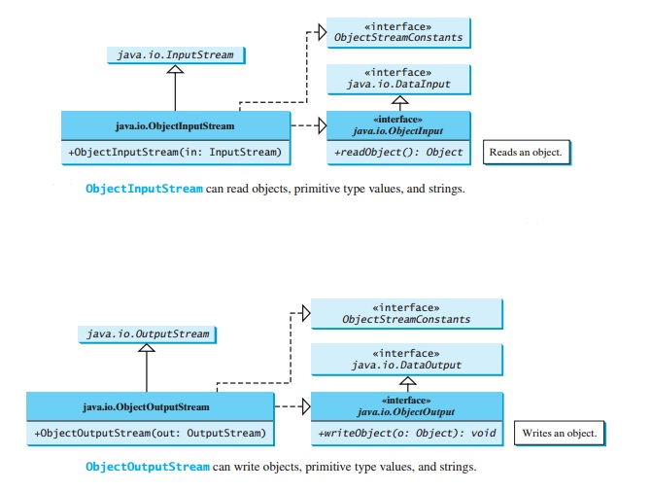

Slide 41
All of these methods will can throw an IOException on error conditions.
The readObject() method may throw java.lang. ClassNotFoundException. The reason is that when the JVM restores an object, it first loads the class for the object if the class has not been loaded.
ClassNotFoundException is a checked exception,

Slide 42
Serialization Example
class MyClass implements Serializable
{
String s;
int i;
double d;
public MyClass(String s, int i, double d) {
this.s = s;
this.i = i;
this.d = d;
}
public String toString()
{
return "s=" + s + "; i=" + i + "; d=" + d;
}
}

Slide 43
import java.io.*;
public class SerializationDemo {
public static void main(String args[]) {
try {
MyClass object1 = new MyClass("Hello", -7, 2.70);
System.out.println("object1: " + object1);
FileOutputStream fos = new FileOutputStream("serial");
ObjectOutputStream oos = new ObjectOutputStream(fos);
oos.writeObject(object1);
oos.flush();
oos.close();
}
catch(IOException e) {
System.out.println("Exception during serialization: " + e);
System.exit(0);
}

Slide 44
// Object deserialization
try {
MyClass object2;
FileInputStream fis = new FileInputStream("serial");
ObjectInputStream ois = new ObjectInputStream(fis);
object2 = (MyClass)ois.readObject();
ois.close();
System.out.println("object2: " + object2);
}
catch(Exception e) {
System.out.println("Exception during deserialization: " + e);
System.exit(0);
}
}
}

